Slide 1


0xCryptography
Basic Ciphers and other Cryptography strategies found in CTFs

Slide 2


What is Cryptography
Cryptography is the practice and study of techniques for secure communication in the presence of third parties.
In CTF’s, the goal is to crack or clone objects or algorithms to reach the flag.

Slide 3
Common Ciphers:
Caeser Shift
ROT1/ROT13 etc etc
Baconian
Transposition
Morse Code
WigWag
Vigenere
True Codes
Enigma Code
Base 64

Slide 4
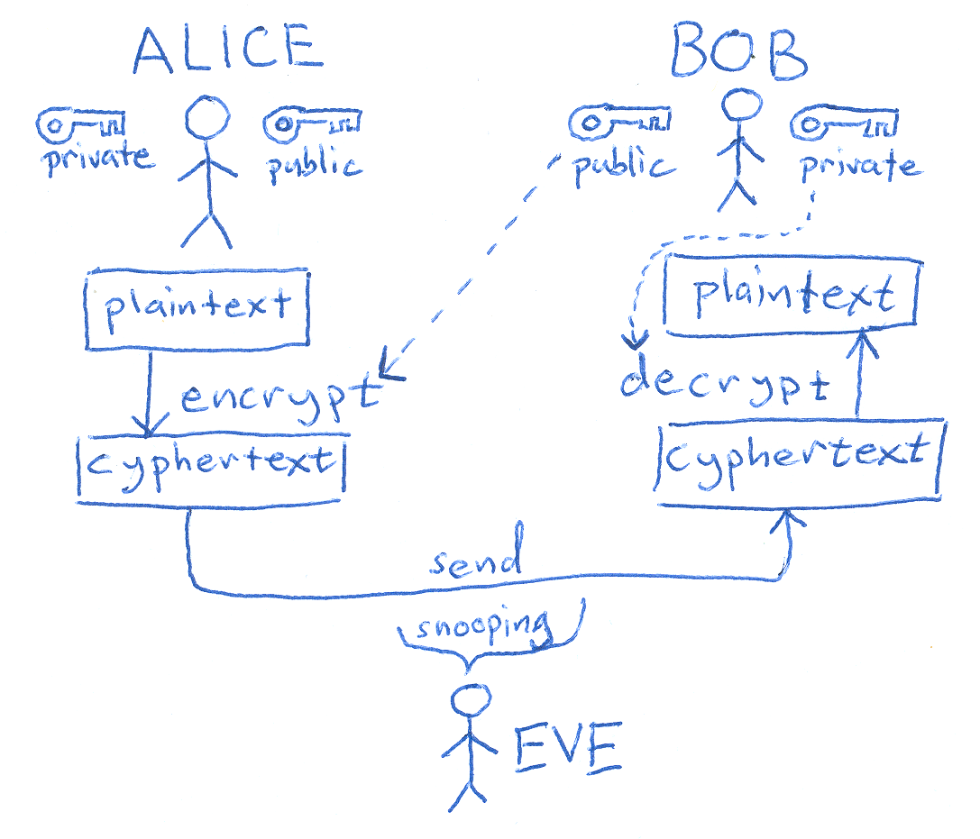
Cryptography in other ways:
Key Management
Understanding Asymmetric vs Symmetric
Certificate Authorities/Servers
XOR, other Bitwise manipulations
Related: Hashing Algorithms

Slide 5
Strategies and Tools:
For basic Ciphers, the best strategy is experience and brute forcing
Algorithms & hashing problems:
Break down the source code, comment along each step, and write a wrapping program that brute forces the hashing until results match
Lots of opensource tools and repos: check the next slide

Slide 6
Example from Past CTF’s
https://github.com/JustinApplegate/thatsnotcrypto

Slide 7
Tools
https://www.dcode.fr/liste-outils#f0
https://github.com/7Hxz233/awesome-ctf-crypto
https://github.com/ashutosh1206/Crypton
https://ctfacademy.github.io/crypto/cyberchef.htm (my personal go to)
https://ctf101.org/cryptography/overview/ More Explanations Here
Other Challenges:
www.CTFLearn.org/
https://www.mysterytwisterc3.org/en/

